Slide 1
Health Information Modeling
Workgroup Meeting
January 13, 2015

Slide 2
AGENDA
Roll Call
Modeling Updates
Presentation/Discussion of FHIM FHIR Roadmap
Review of Vital Signs Model
VSAC Update (tentative)
2

Slide 3
FHIM FHIR Roadmap
January 2015

Slide 4
FHIM Background
The Federal Health Information Model (FHIM) is an implementation, agnostic Unified Modeling Language (UML) model focusing on the information exchange requirements. It is the cornerstone of the Federal Health Architecture Model Driven Approach to harmonizing and defining Health Standards.

Slide 5
FHIM Current MDA Features
FHIM to Model Driven Health Tools CDA transformation: Provides the ability to create a CDA Implementation Guide and runtime from the FHIM content. See https://www.projects.openhealthtools.org/sf/projects/mdht/
FHIM to NIEM transformation: Provides the ability to create NIEM Information Exchange Package Documentation from the FHIM Content See https://www.niem.gov/technical/Pages/niem-uml.aspx

Slide 6
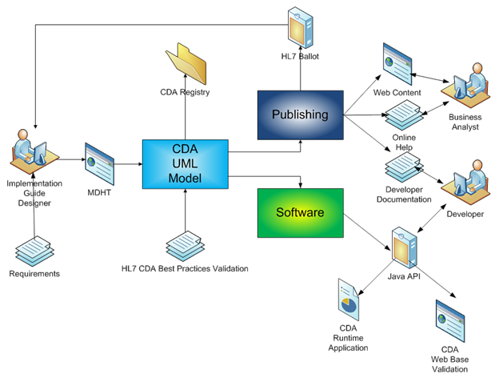
MDHT Workflow

Slide 7
Fast Healthcare Interoperability Resources (FHIR)
FHIR is the next evolution of Health Level Seven (HL7) standards. The methodology is to combine the standards development with corresponding implementations through a tooling driven approach.
We believe that FHIR represents a significant step forward for HL7 and health information exchange. The recent announcement of the FHIR/Argonaut project solidifies FHIR’s role in the interoperability landscape going forward.

Slide 8
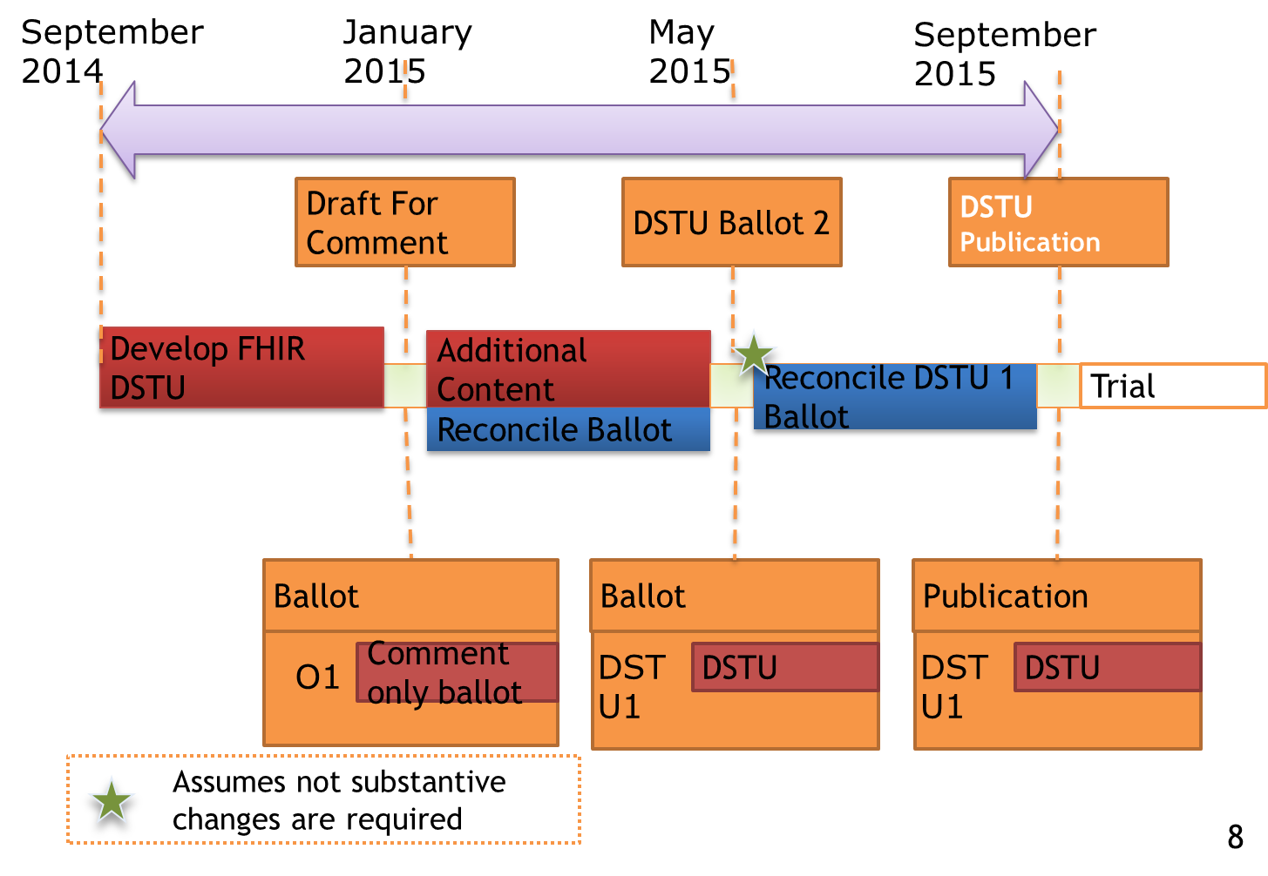
FHIR Ballot Map
Notes:
This slides illustrates iterative ballots that address the balloting and approval of a DSTU ballot (e.g. FHIR).

Slide 9
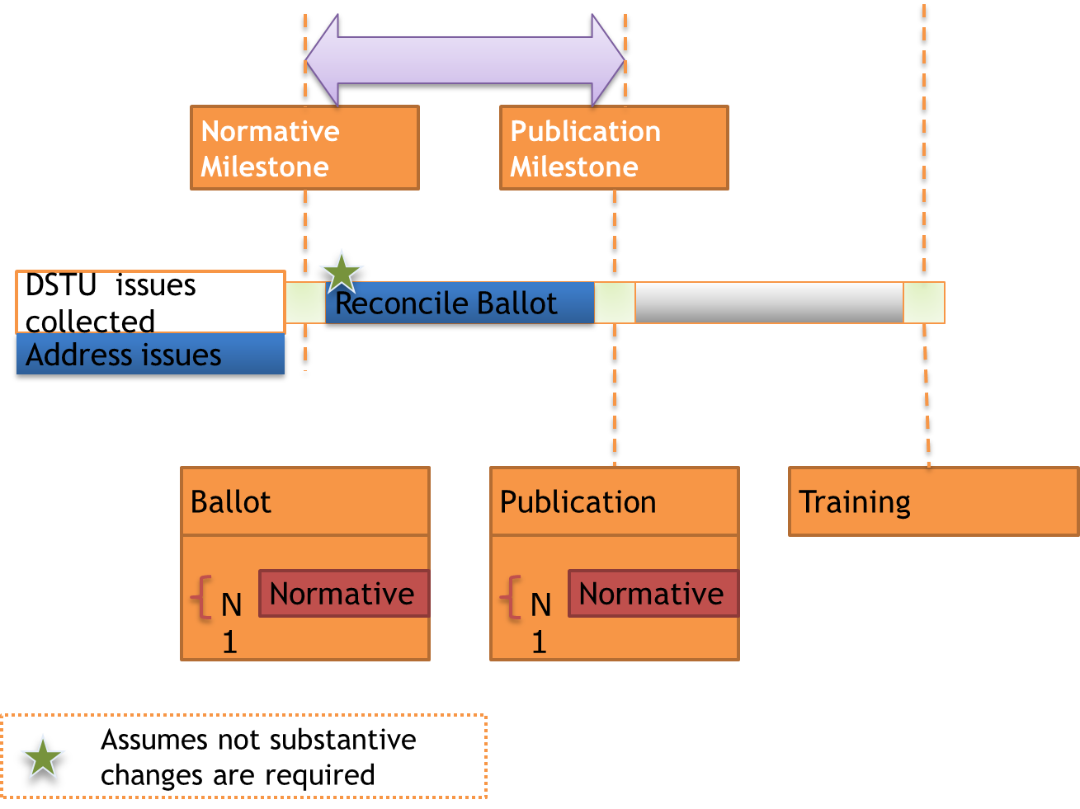
FHIR Ballot Map
9
Notes:
After the trial period, a standard may be balloted again as normative and added to the normative edition publication. This completes the normative specification but the project team may continue to issue maintenance releases of the specification using the same process outlined here.

Slide 10
FHIR Basics
Resources - This specification defines a series of different types of resources that can be used to exchange and/or store data in order to solve a wide range of healthcare related problems, both clinical and administrative.
Extensions - Extensibility is a fundamental part of the design of this specification. Every element in a resource may have extension child elements to represent additional information that is not part of the basic definition of the resource. Applications should not reject resources merely because they contain extensions, though they may need to reject resources because of the specific contents of the extensions.
Profile - A statement of use of one or more FHIR Resources. It may include constraints on resources and data types, terminology binding statements and extension definitions.

Slide 11
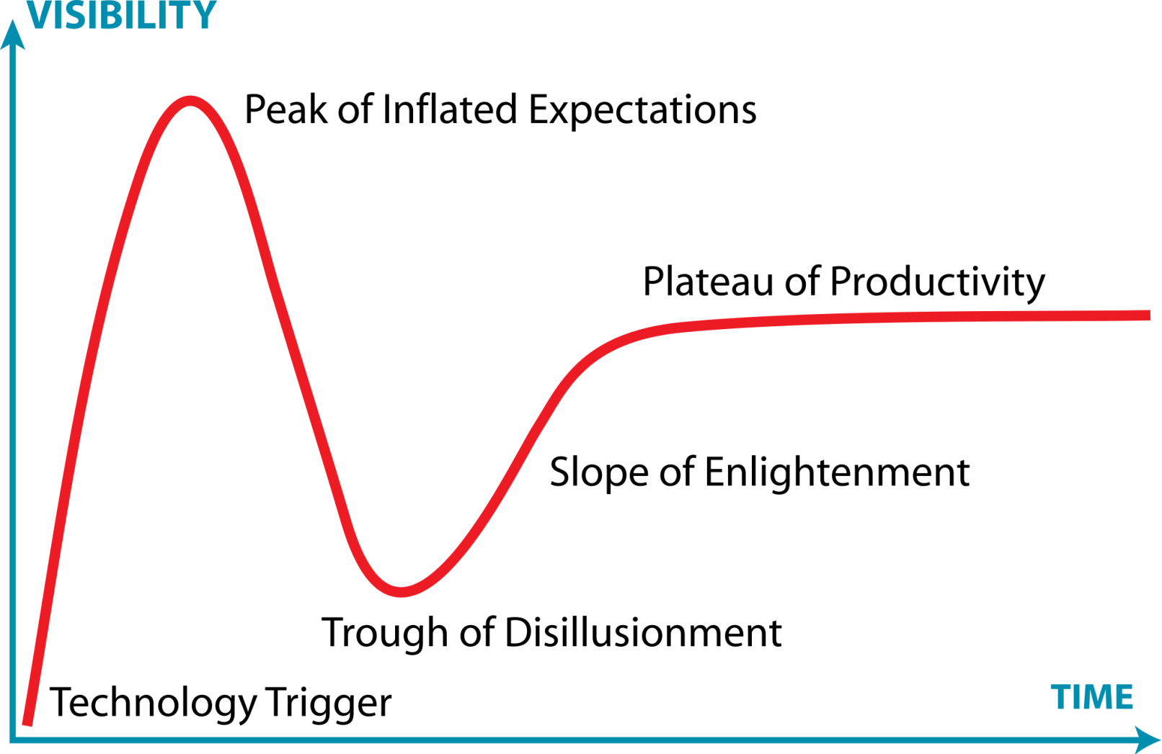
FHIR Emerging Technologies Cycle

Slide 12
FHIR Concerns
Decentralized approach to resource definitions
Leaving behind lessons learned
Missing clear path for Terminology/FHIR integration
Lack of rigor for resource definitions
Extensions enables too much point to point collaboration

Slide 13
FHIM to FHIR Transformation
The FHIM to FHIR transformation will support the ability to create the required resource, extensions, and profiles to support an exchange use case. An important part of the FHIM approach is to leverage other projects support the generation of the implementation artifacts.
Currently we are looking to leverage the HAPI - FHIR project to generate the artifacts. See http://jamesagnew.github.io/hapi-fhir/

Slide 14
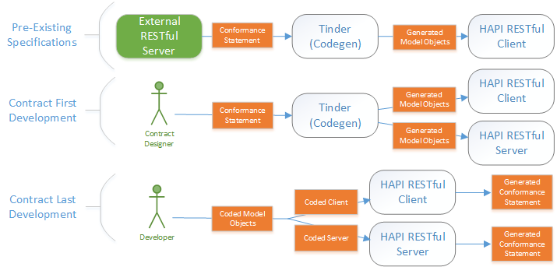
HAPI/FHIR Methodology

Slide 15
FHIR Concerns Revisited
Decentralized approach to resource definitions - The FHIM provides a centralized approach to resource definitions.
Leaving behind lessons learned - The FHIM origins are of harmonization so multiple sources have been used to validate model.
Missing clear path for Terminology/FHIR integration - The FHIM has a clear integration plan for developing terminologies and leveraging them. The MDA approach allows us to create requirements for FHIR terminology while not being handcuffed by a particular implementation.
Lack of rigor for resource definitions - The underlying UML model provides the missing rigor to the definitions through model validation.
Extensions enables too much point-to-point collaboration - Extensions are centralized in the FHIM so there is visibility and accessibility to the extension definitions.

Slide 16
FHIM to FHIR Road Map
Q1 : Extend HAPI FHIR implementation
Q2 : Incorporate FHIR Terminology extensions
Q3 : Generate from FHIM conformance and coded models
Q4 Publish FHIR resource artifacts for a use case exchange defined in the FHIM

Slide 17
Questions ?

Slide 18
Resources
Federal Health Information Model
http://www.fhims.org/
Health Level Seven FHIR
http://www.hl7.org/implement/standards/fhir/
HAPI-FHIR
http://jamesagnew.github.io/hapi-fhir/
NIEM
https://www.niem.gov/technical/Pages/niem-uml.aspx
MDHT
https://www.projects.openhealthtools.org/sf/projects/mdht
Model Driven Architecture (MDA)
http://www.omg.org/mda/

